Slide 1
Animation
CS 460: COMPUTER GRAPHICS

Slide 2
Two Parts
Overview: Making Computer Animations
Animation Principles
Note: The material presented here only gives you some very basic
ideas about computer animations. In reality, it really requires you
to take several courses and to do some real work to learn it.

Slide 3
Part I: Overview
Making Computer Animations

Slide 4
Part I: Contents
Process of creating an animation
Production Staff involved
Elements for a Good CG Animation
Useful Technical Information
Note: This lecture is really a very brief overview.
Hundreds of books can be found on this topic.

Slide 5
Basic Steps in Movie Making
Idea
Script
Initial Sketch
Planning
Visualizing
Storyboard
Modeling/Textures
Layout Design
Animation
Shot Design
Lighting
Editing
Storyboard
Rendering

Slide 6
Production Staff: Animation
1. Character Animator
2. Character Technical Director
3. Digital Painter
4. Modeling Technical Director
5. Shader Technical Director
6. Lighting Technical Director
7. Render Wrangler/Technical
Assistant
8. Music/Sound Director
9. Director
10. Art Director
11. Story Developer
12. Production Designer
13. Sculptor
14. Executive Producer
15. Producer
16. Animation Coordinator
17. Producer Assistant
18. Programmer

Slide 7
Basic Elements for a Good CG Animation
Idea
Story Board
Shots (select good camera views)
Lighting and Shadow
Staging
Music and Sound Effects
Editing

Slide 8

Idea

Slide 9
Story Board
Collection of drawings illustrating key images within an animation sequence
Communication between designer and animator: provide a simple mechanism for expressing concepts such as scale, pace, perspective, dynamics, timings, scene changes etc.
Should tell the story of the animation, i.e. storytelling
Also need to think about the scene and the casting

Slide 10
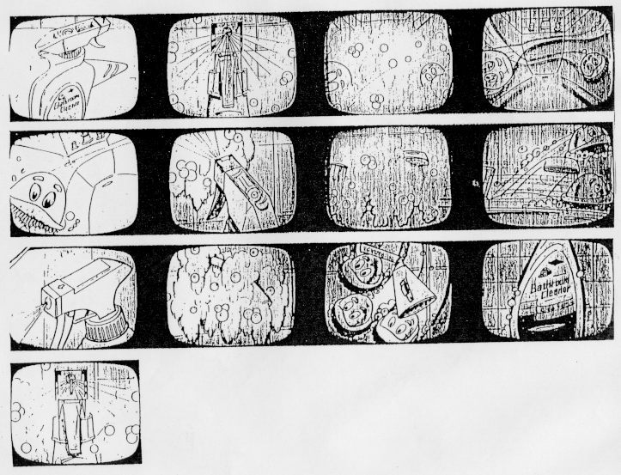
Story Board

Slide 11
Shots / Camera views
Basics: Planning the Shots
  Think like a filmmaker, your ultimate goal is to develop a story through you animation. Make it storytelling!
  - Think like a director: Envision all your shots in your mind
Technical: Cinematic Principles
  A Shot: 1. Camera angle (field-of-view) and 2. Frame size
  Use of different types of shots suitably
  Use of different types of camera movements suitably
Note: a shot is a consecutive series of pictures
that constitutes a unit of action in a film.

Slide 12
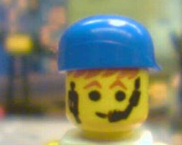
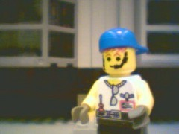
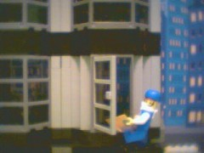
Shots / Camera views
Use of different type of shots suitably:
  Close-up - shows detail, e.g. facial expression
  Medium shot (Torso) - shows the subject in relation to the immediate context.
  Long shot (Full shot or Wide shot) - shows the subject in relation to the overall context
  There are a lot more…
Reference: http://www.cssd.ab.ca/tech/digvid/cameraangles.html

Slide 13
Shots / Camera views
Use of different type of camera movements suitably
  Dolly – moves horizontally across the scene
  Pan – rotates left to right or right to left (fixed position)
  Tilt – rotates up and down (fixed position)
  Zoom – change focal length (or field-of-view)
  There are a lot more …
  https://www.youtube.com/watch?v=R9JWgU9YVcU

Slide 14
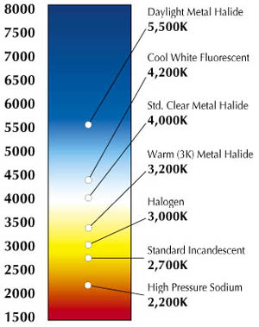
Lighting and Shadow
After you planned your shots…
Lighting:
  Avoid too much ambient light
  Too artificial; Lose scene richness
  Light color and scene color (artist choice)
  Audience’s feeling: warmness of the environment
  Light and shadow:
  Make your objects look more three-dimensional
  and more realistic in the scene
  Three-point lighting method:
  Key, Fill, and Backlight
  (Originally from traditional films, but used in CG later)
cold
warm

Slide 15

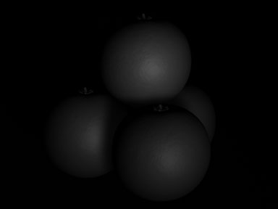

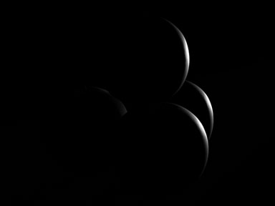

Key Light
Fill Light
Key + Fill
Look more
three-dim.
Back Light (Rim Light
or Hair Light)
Key + Fill + Back
Reference: http://www.andrew-whitehurst.net/3point.html

Slide 16
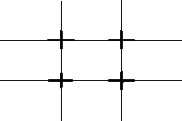
Staging
It is the positioning of digital actors, objects, and environments
relative to the camera (same as photography):
One Basic Principle: The Rule of Thirds
  Divide the view into nine regions
  Produces four intersection points
  Normally, our eyes automatically go to these points
  So, center the subject(s) around these points, along the two horizontal lines or the two vertical lines
  The key: Balance between the object and the background
Other principles, e.g. illusion of depth, etc.
Tons of examples: http://www.google.com.hk/search?hl=zh-TW&q=Rule+of+Thirds&meta
Or in common photography books

Slide 17
Music and Sound Effects
In General:
Should be used appropriately to enhance and complete every shot in the animation
Silence: Create Tension (e.g. horror movie)
Technical:
Sampling rate? Stereo? Multi-channel? Surround?
Audio Mixing

Slide 18
Editing
This is done after rendering each shot…
Then, we add
  Music and sound
  Special effects, e.g. Earthquake, screen-based effects, etc.
  Text, e.g. title, credit, etc.
  Cuts
  Joining of a shot to another is called a “cut”
  Originated from the fact that in the old days, editors have to cut the film pieces in traditional filmmaking.

Slide 19
Some Technical Information
Aspect Ratio, Resolution, and Frame Per Second
  Aspect Ratio of the physical screen
    16:9 e.g. film, etc.
    4:3 e.g. normal TV, etc.
    Note: this affects storyboarding, shot planning, etc.
  Resolution of the digital video
    NTSC 720 x 480 or 720 x 486
    PAL 720 x 576 or 752 x 576
    HDTV 1920 x 1080 or 1280 x 720 or …
    VGA 640 x 480
    SVGA 800 x 600
    XGA 1024 x 768
Note: a pixel in the video may not be
a square on the physical screen

Slide 20
Some Technical Information
Aspect Ratio, Resolution, and Frame Per Second
  Frame per second (fps)
    Film 24 fps (Traditional)
    NTSC 30 fps
    PAL 25 fps
    HDTV 60/30/24 fps

Slide 21
Some Technical Information
Video Overscan
  TV projects images onto the screen slightly larger than the actual screen size.
  (due to inconsistencies of CRT TV production from 30’s to 70’s.)
  Therefore, portion of the video near the edges would be cropped off of the screen.
  This is called “overscanning.”
  Old TVs had a larger amount of overscanning.

Slide 22
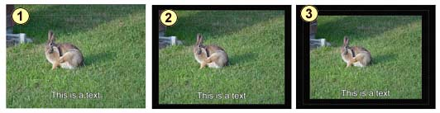
Some Technical Information
Video Overscan
  Picture safe area (95%)
  Objects outside this region is likely to be cropped off by the majority of TVs.
  Action safe area (90%)
  Important actions should be kept inside this range
  Title safe area (80%)
  Text such as titles should be kept inside this range

Slide 23
Part II:
Animation Principles
References:
www.siggraph.org/education/materials/HyperGraph/animation/character_animation/principles/prin_trad_anim.htm
www.evl.uic.edu/ralph/508S99/contents.html
A quick overview:
https://www.youtube.com/watch?v=l8pycG64cxI

Slide 24
Disney’s Animation Principles
Introduction:
In 1930, a number of principles in making traditional animations were developed at Walt Disney Studio to make the characters more realistic and more entertaining.
Computer Animators adapted these principles for computer animations.

Slide 25
Disney’s Animation Principles
Lasseter (1987) (Executive Vice President of Pixar) wrote:
"Whether it is generated by hand or by computer, the first
goal of the animator is to entertain. The animator must have
two things: a clear concept of exactly what will entertain
the audience; and the tools and skills to put those ideas across
clearly. Tools, in the sense of hardware and software, are
simply not enough."
Note: Not just applied to computer animation.
Its purpose is to pass knowledge to the audience.

Slide 26
Disney’s Animation Principles
Squash and Stretch
Timing and Motion
Anticipation
Staging
Follow Through and Overlapping Action
Straight Ahead Action and Pose-To-Pose Action
Slow In and Out
Arcs
Exaggeration
Secondary Action
Appeal
Strong Drawing or Solid Drawing (some references include this also, Lasseter skipped this)

Slide 27
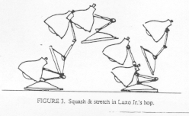
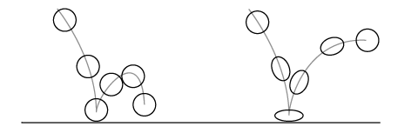
Squash and Stretch
Principle #1:
Defining the rigidity and mass of an object by distorting its shape during an action
Squash: flatten an object or character by pressure or by its own power
Stretch: used to increase the sense of speed and emphasize the squash by contrast
Note: keep volume constant
[Luxo, jr’s hop]
[Video: https://www.youtube.com/watch?v=D4NPQ8mfKU0]

Slide 28
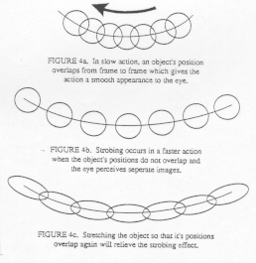
Squash and Stretch
Strobing Effect:
Reveal the speed and relieve the disturbing effect of strobing

Slide 29
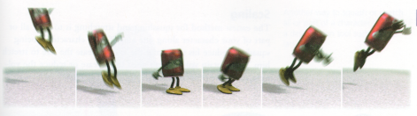
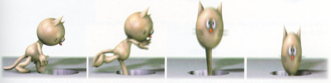
Squash and Stretch
More Examples:

Slide 30
Timing and Motion
Principle #2:
Timing, or the speed of an action, is an important principle because it gives meaning to movement.
Note:
The speed of an action defines how well the idea behind the action will read to an audience. It reflects the weight and size of an object, and can even carry emotional meaning.
Proper timing is critical to making ideas readable. It is important to spend enough time (but no more) preparing the audience for: the anticipation of an action; the action itself; and the reaction to the action. If too much time is spent on any of these, the audience's attention will wander. If too little time is spent, the movement may be finished before the audience notices it, thus wasting the idea.

Slide 31
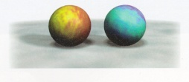
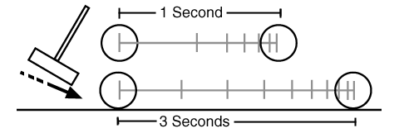
Timing and Motion
Weight:
Two objects, identical in size and shape, can appear to be two
vastly different weights by manipulating timing alone.
A heavy body is slower to accelerate and decelerate than a light one. The way an object behaves on the screen, the effect of weight that it gives, depend entirely on the spacing of the poses and not on the poses themselves.
heavier

Slide 32
Timing and Motion
2. Scaling Properties:
Timing can also contribute to size and scale of an object or character. A larger character has more mass, more weight and more inertia than a tiny character, therefore it moves slower. In contrast, a tiny character has less mass, weight, and inertia, therefore its movements are quicker.
3. Determining Emotion:
Timing plays an essential role in illustrating the emotional state of an
object or character. It is the varying speed of the characters
movements that indicate whether a character is lethargic, excited,
nervous, or relaxed.
[Ref anim]

Slide 33
Anticipation
Principle #3:
An action occurs in three parts: the preparation for the action, the action itself, and the termination of the action. Anticipation is the preparation for the action.
Anticipation is the act of letting the audience have a clue as to what is about to happen. This can be a broad physical gesture, or it can be as simple as an expression or subtle motion.
The idea is that each motion should not come unexpectedly (unless that is the desired effect).
This helps the action "flow over" the audience, and make the characters more believable.

Slide 34
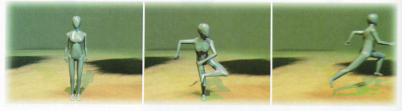
Anticipation
Anticipation can also emphasize heavy weight, as for a character picking up an object that is very heavy. An exaggerated anticipation, like bending way down before picking up the objects, helps the momentum of the character to lift the heavy weight.
Preparation for action!

Slide 35
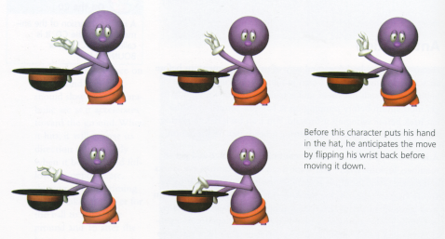
Anticipation
Here!

Slide 36
Staging
Principle #4:
Staging is the presentation of an idea so that it is completely and unmistakably clear. To stage an idea clearly, the audience's eye must be led to exactly where it needs to be at the right moment.
The object of interest should contrast from the rest of the scene. In a still scene, the eye will be attracted to movement. In a very busy scene, the eye will be attracted to something that is still. The animator has to design some techniques to make it stand out from the others.

Slide 37
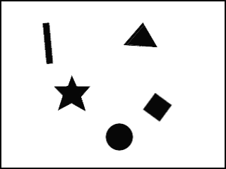
Staging
A moving object
surrounded
by static objects
A static object
surrounded
by moving objects

Slide 38
Follow Through and Overlapping Action
Principle #5:
Follow through is the termination of an action.
Actions very rarely come to a sudden and complete stop, but are generally carried past their termination point. For example, a hand, after releasing a thrown ball, continues past the actual point of release.
Quote from Walt Disney:
"It is not necessary for an animator to take a character to one point, complete that action completely, and then turn to the following action as if he had never given it a thought until after completing the first action. When a character knows what he is going to do he doesn't have to stop before each individual action and think to do it. He has it planned in advance in his mind."

Slide 39
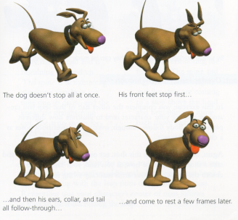
Follow Through and Overlapping Action
Example:
Follow Through

Slide 40

Follow Through and Overlapping Action
Example:
Follow Through
Stretch out a bit

Slide 41
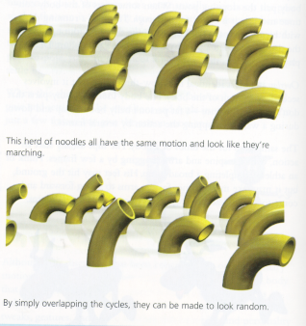
Follow Through and Overlapping Action
Overlapping action is virtually the same as follow through, only it overlaps with the action taking place. An action should not be brought to a complete stop before starting another action, and the second action should overlap the first. Overlapping maintains a flow and continuity between whole phrases of actions.
(a) The herd of noodles all have the same
motion and look like they’re matching
(b) By simply overlapping the cycles,
they can be made to look random

Slide 42
Straight Ahead Action and Pose-To-Pose Action
Principle #6:
Straight Ahead Action in hand drawn animation is when the animator starts at the first drawing in a scene and then draws all of the subsequent frames until he reaches the end of the scene. This creates very spontaneous and zany looking animation and is used for wild, scrambling action.
Pose-to-Pose Action is when the animator carefully plans out the animation, draws a sequence of poses, i.e., the initial, some in-between, and the final poses and then draws all the in-between frames (or another artist or the computer draws the in-between frames). This is used when the scene requires more thought and the poses and timing are important.
https://www.youtube.com/watch?v=v8quCbt4C-c
Notes:
http://www.youtube.com/watch?v=4dHpdtZQ4vA
http://www.youtube.com/watch?v=1tyVBhN_uK4

Slide 43
Straight Ahead Action and Pose-To-Pose Action
Note:
This is similar to keyframing with computer graphics but it must be modified slightly since the in-betweens may be too unpredictable.
Pose-to-pose action is an important tool in computer animation. Objects are built in a hierarchy, where each layer of the hierarchy has an associated transformation. Animation is then built up one transformation at a time from one pose to the next. For example, when animating a person walking, you would first set the pose position for the hips at the start of the motion, then you would adjust the hip translation for the end of the action. Then building upon this original pose, you would transform other objects in the model, until you had traversed the hierarchy.

Slide 44
Slow In and Out
Principle #7:
This deals with the spacing of the in-between drawings between the extreme poses.
In reality, nothing starts in motion abruptly with no acceleration. Even a bullet shot from a gun has a short period of acceleration. Except for the most unusual of circumstances does the motion of an object have an instantaneous start or stop.
Ease-in and ease-out is the acceleration and deceleration of an object in motion. Eases may be applied to any motion track, whether it is rotation, scaling, color or translation.

Slide 45
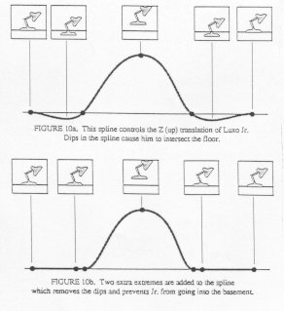
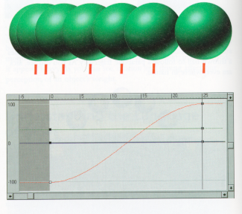
Slow In and Out
Examples:

Slide 46
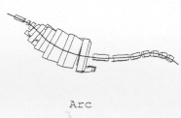
Arcs
Example: a tail
Principle #8:
Visual path of action for
natural movement
Like ease in and ease out, objects tend to
move in arcs. The wagging of a tail would
be an arc and not a straight line. Straight
lines are not a natural motion. Arcs should
be used whenever possible to avoid a linear stiff looking motion.
Arcs in nature are the most economical routes by which a form can move from one position to another. In animation, such arcs are used extensively, for they make animation much smoother and less stiff than a straight line for the path of action.
Use curves

Slide 47
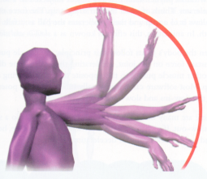
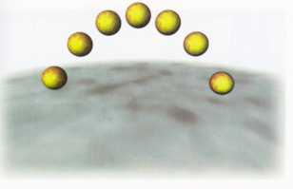
Arcs
Example:
A ball thrown in the air also
follows an arc.
Example:
The rotation of an arm’s joints causes the hand to move along an arc.

Slide 48
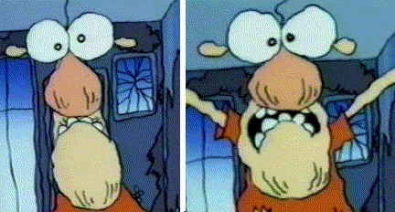
Exaggeration
Principle #9:
Get to the heart of the idea and emphasize it so the audience sees it.
The animator must go to the heart of anything or any idea and develop its essence, understanding the reason for it, so that the audience will also understand it. If a character is sad, make him sadder; if he is bright, make him shine; worried, make him fret; wild, make him frantic.
Consider extrapolation in CG;
go beyond the keyframes

Slide 49
Exaggeration
If a scene is animated with little or no exaggeration, the motion will be dull and lifeless. Exaggeration helps to put more juice in the scene.
A scene has many components to it: the design, the shape of the objects, the action, the emotion, the color, the sound. Exaggeration can work with any component, but not in isolation. The exaggeration of the various components should be balanced. If just one thing is exaggerated in an otherwise lifelike scene, it will stick out and seem unrealistic.

Slide 50
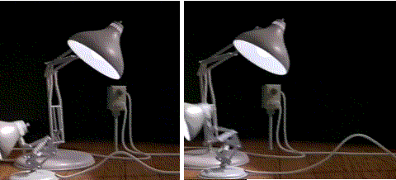
Secondary Action
Principle #10:
It is an action that results directly from another action. Secondary actions are important in heightening interest and adding a realistic complexity to the animation.
Example: The
secondary action of
Luxo Jr's forward
motion is the rippling
of his power cord.
[Video: https://www.youtube.com/watch?v=6G3O60o5U7w]

Slide 51
Appeal
Principle #11:
Creating a design or an action that the audience enjoys watching: a quality of charm, pleasing design, simplicity, communication.
Your eye is drawn to the figure or object that has appeal, and, once there, it held while you appreciate the object.
A weak drawing or design lacks appeal. A design that is complicated or hard to read also lacks appeal. Clumsy shapes and awkward moves all have low appeal.
Where the live action actor has charm, the animated character has appeal.
Think about some cartoon characters you like …

Slide 52
Strong Drawing or Solid Drawing
Principle #12:
Solid drawing in conventional animation refers to the fact that the characters should be drawn in such a way that they look 3D.
In computer generated animation, solid drawing applies to the design of the character. One should design a character such that it is flexible enough to do the action that the story requires without appearing stiff or awkward.
The character design must be appropriate for the sophistication of the software and hardware.

Slide 53
Summary
“Personality” in character animation is not a principle onto itself, but the intelligent application of all of the principles of animation.
When character animation is successful and the audience is thoroughly entertained, it is because the characters and the story have become more important and apparent than the technique that went into the animation.
Whether drawn by hand or computer, the success of character animation lies in the personality of the characters.
When defining the character, it is important to make the personality distinct, and at the same time have characteristics that are familiar to the audience.

Slide 54
Summary
If the actions of a character ring true, the audience will be able to relate to
the character, and he will be believable to them.
Remarks:
The first goal of the animator is to entertain, and an animator must have two things (as mentioned previously):
  1. a clear concept of exactly what will entertain the audience;
  2. the tools and skills to put those ideas across clearly and unambiguously.
Tools, in the sense of hardware and software, are simply not enough. The above principles are tools as well... tools which are just as important as the computers we work with.
Story development and art/animation personnel and decisions are what make the movie.
Same is true for game development.

Slide 55
Summary
“There is no particular mystery in animation... it's really very simple, and like anything that is simple, it is about the hardest thing in the world to do.”
Bill Tytla at the Walt Disney Studio, 1937.
Quick Review of the 12 principles:
https://www.youtube.com/watch?v=iFC_gKHx7FE

Slide 56
Last word…
Some Techniques in Movie Industry / TV
Motion Capture and Motion Transfer
http://www.siggraph.org/education/materials/HyperGraph/animation/character_animation/motion_capture/motion.htm
https://www.youtube.com/watch?v=1wK1Ixr-UmM
Image-based Modeling, Rendering, and Relighting
http://graphics.lcs.mit.edu/ibedit
Cartoon Rendering
http://www.siggraph.org/s2004/conference/sketches/sketches26.php?=conference
There are a lot more…
Use creativity and research…

Slide 57
References and further reading
Reference:
“Digital Cinematography & Directing,”
by Dan Ablan, New Riders Press; (December 3, 2002)
Frank, T. & Johnston, O. 1981. Disney Animation -- The Illusion of Life, New York: Abbeville Press.
“Principles of Traditional Animation Applied to 3D Computer Animation”
John Lasseter, Computer Graphics, pp. 35-44, 21:4,
July 1987 (SIGGRAPH 87).
www.siggraph.org/education/materials/HyperGraph/animation/character_animation/principles/prin_trad_anim.htm
and his SIGGRAPH94 course notes, “Animation Tricks,”
www.siggraph.org/education/materials/HyperGraph/animation/character_animation/principles/lasseter_s94.htm
WWW Animation Book by Rick Parent, Ohio State University
www.siggraph.org/education/materials/HyperGraph/animation/rick_parent/Outline.html
Electronic Visualization Lab. at UIC
http://www.evl.uic.edu/ralph/508S99/contents.html

